Slide 1
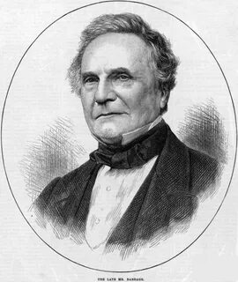
Charles Babbage
A Pioneer of 19th-Century Computer Technology

Slide 2
Who Was Charles Babbage?
Charles Babbage
Lifespan: 1791–1871
Profession: Mathematician, Inventor, Philosopher
Key Achievements:
Designed the Difference Engine
Proposed the Analytical Engine – the first conceptual computer
Fun Fact: Known as the "Father of Computing," though his machines were never fully built in his lifetime.

Slide 3
The Difference Engine (1822)
Purpose: Automatically compute mathematical tables (logarithms, polynomials)
How It Worked:
Used decimal number system
Mechanical calculations without human errors
Why It Wasn’t Completed: Complexity and lack of funding

Slide 4
The Analytical Engine (1837)
The First Programmable Computer!
Key Components (Similar to Modern Computers):
"Mill" (CPU) – Performed calculations
"Store" (Memory) – Stored data and results
Punch Cards (inspired by Jacquard’s loom) – Program input
Speed: Solved complex problems in minutes (revolutionary for the 1800s)

Slide 5
Why Was Babbage Ahead of His Time?
His ideas were only realized in the 20th century
Ada Lovelace (the first programmer) wrote an algorithm for his machine
In 1991, the Difference Engine No. 2 was built and worked flawlessly!

Slide 6
Babbage’s Legacy
Modern computers wouldn’t exist without his ideas
The Babbage Medal is awarded for contributions to computer science
Quote: "Every minute of his machine’s work saves an hour of mental labor."

Slide 7
Conclusion
Babbage was a genius ahead of his era.
His machines laid the foundation for the computer revolution.

Slide 8
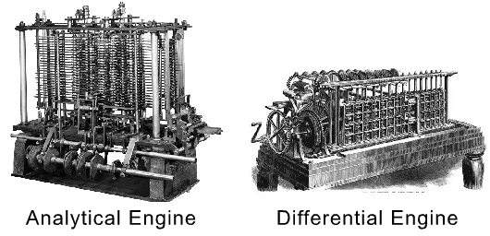
Thank you for your attention!

